Slide 1
Hypothesis Testing Process
Non Parametric tests
Week 10

Slide 2
Recap
In Week 9
  Hypothesis testing process
  Parametric Tests ANOVAS
  Correlations
This week
  Non Parametrics test

Slide 3

Types of statistical test
Step 4
Choose the statistical test
Data | Test type | Sample size | Data distribution | Variance | Outliers | Statistical tests
Interval Scale without a fundamental zero | Parametric statistical test | Large sample | data is normally distributed | Equal variances | No Outliers | z-Tests
 |  |  |  |  |  | t-Tests
Ratio Scale with a fundamental zero
 |  |  |  |  |  | ANOVA
Nominal categorical | Non parametric statistical test | Small sample | data is NOT normally distributed | Unequal variances | Outlies | Chi-square Test
Ordinal Rank or order

Slide 4
Commonly used test in usability testing
Step 4
Choose the statistical test
Commonly Used Significance Tests for Comparing Means and Their Application Context
Experiment Design | Independent Variables (IV) | Conditions for each IV | Types of Test
Between-group | 1 | 2 | Independent-samples t test
 | 1 | 3 or more | One-way ANOVA
 | 2 or more | 2 or more | Factorial ANOVA
Within-group | 1 | 2 | Paired-samples t test
 | 1 | 3 or more | Repeated measures ANOVA
 | 2 or more | 2 or more | Repeated measures ANOVA
Between- and within-group | 2 or more | 2 or more | Split-plot ANOVA

Slide 5
Non-Parametric tests
Assumptions for parametric tests require several general assumptions:
  the data is normally distributed
  the variables should be at least scaled by intervals
  the variance in the data collected from different groups should be approximately equal
In reality, those assumptions may not be met
Notes:
All the analysis methods discussed in the previous sections are parametric tests that require several general assumptions. First, the data needs to be collected from a population that is normally distributed. Usually we consider this assumption as being met if the population has an approximately normal distribution. Second, the variables should be at least scaled by intervals. That is, the distance between any two adjacent data units should be equal. For example, when examining the age variable, the distances between 1 and 2, 2 and 3, and 80 and 81 are all equal to each other. And third, for tests that compare means of different groups, the variance in the data collected from different groups should be approximately equal.

Slide 6
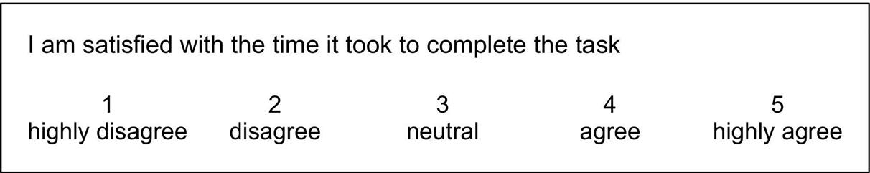
Non-Parametric tests
In reality:
The data we have maybe poorly approximated to normal distribution.
Hypotheses may have to be measured through categorical variables (e.g., race or gender) or ordinal variables (e.g., ranking scales) where different items are compared directly with each other.
  In these cases, the intervals between the values may not be equally spaced.
  The distance between the two adjacent data points can be unequal. The same problem exists for questions that require “yes” or “no” answers or ask participants to rank a number of options.
Notes:
Some hypotheses may have to be measured through categorical variables (e.g., race or gender) or ordinal variables (e.g., ranking scales) where different items are compared directly with each other. In these cases, the intervals between the values are not equally spaced. For example, when collecting subjective satisfaction about an application, you may use a Likert scale question, as shown in Figure 4.3. In this case, the distance between the two adjacent data points can be unequal. The same problem exists for questions that require “yes” or “no” answers or ask participants to rank a number of options.

Slide 7
Non-Parametric tests
When the assumptions of parametric tests are not met, you need to consider the use of nonparametric analysis methods.
Compared to parametric tests, nonparametric methods make fewer assumptions about the data.
Although nonparametric tests are also called “assumption-free” tests, it should be noted that they are not actually free of assumptions.
For example, the Chi-squared test, one of the most commonly used nonparametric tests, has specific requirements on the sample size and independence of data points.

Slide 8
Non-Parametric tests
Another important point for nonparametric analysis is that information in the data can be lost when the data tested are actually interval or ratio.
The reason is that the nonparametric analysis collapses the data into ranks so all that matters is the order of the data while the distance information between the data points is lost.
Therefore, nonparametric analysis sacrifices the power to use all available information to reject a false null hypothesis in exchange for less strict assumptions about the data.
  MacKenzie S. (2013) Human-Computer Interaction: An Empirical Research Perspective. Waltham, MA: Elsevier.

Slide 9
Parametric vs Nonparametric
Parametric Alternative | Nonparametric test
Independent samples t-test | Mann-Whitney test
Paired sample t-test | Wilcoxon Signed Rank test
One-way ANOVA or Factorial ANOVA | Kruskal-Wallis test
Repeated ANOVA | Friedmans’s ANOVA
Correlation Coefficient | Spearman Rank Correlation
Same distribution
Symmetric distribution
Same distribution
Equal variances
Interval, ratio or ordinal
Monotonic relationship
Interval or ratio | Nominal or ordinal
Normally distributed | Not Normal distribution
No outliers | Outliers
Equal variances | Unequal variances
Large samples >30 | Small sample
Notes:
Every parametric test has the equivalent non parametric test

Slide 10
Chi-Squared Test
In user studies, we frequently encounter situations where categorical data (e.g., yes or no) are collected and we need to determine whether there is any relationship in the variables.
Those data are normally presented in tables of counts (also called contingency tables) that can be as simple as a 2-by-2 table or as complicated as tables with more than 10 columns or rows.
A 2-by-2 Frequency Count Table
blank cell | Preferred Device
Age | Mouse | Touchscreen
< 65 | 14 | 6
≥ 65 | 4 | 16

Slide 11
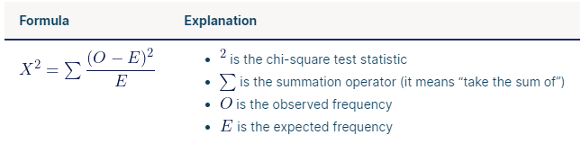
Chi-Squared Test - example
A 2-by-2 Frequency Count Table
blank cell | Preferred Device
Age | Mouse | Touchscreen
< 65 | 14 | 6
≥ 65 | 4 | 16
The table shows that participants under the age of 65 prefer the mouse while more senior participants prefer the touchscreen.
To examine whether this result is merely by chance or there is indeed a relationship between age and the preference for pointing devices, you can run a Chi-squared test.
the observed frequency is the values we get from the observations
the expected frequency is the total we could have (e.g. in our example 20)

Slide 12
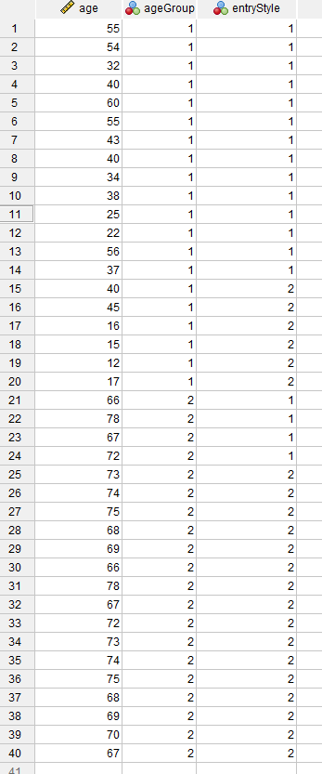
Chi-Squared Test – data organisation in SPSS
A 2-by-2 Frequency Count Table
blank cell | Preferred Device
Age | Mouse | Touchscreen
< 65 | 14 | 6
≥ 65 | 4 | 16

Slide 13
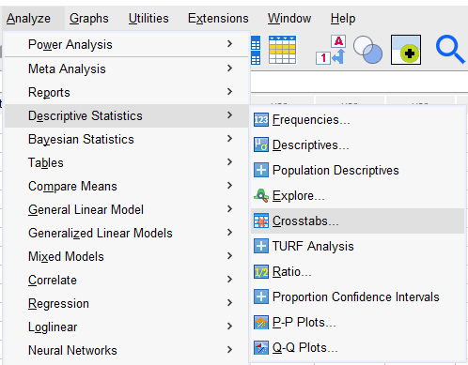
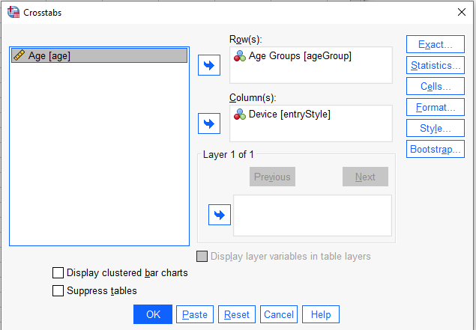
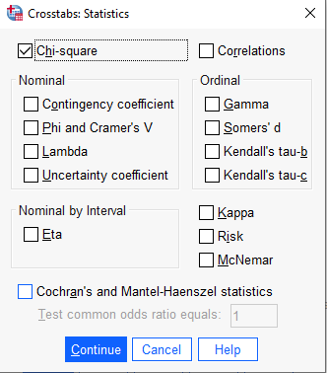
Run Chi-Squared Test in SPSS
A 2-by-2 Frequency Count Table
blank cell | Preferred Device
Age | Mouse | Touchscreen
< 65 | 14 | 6
≥ 65 | 4 | 16

Slide 14
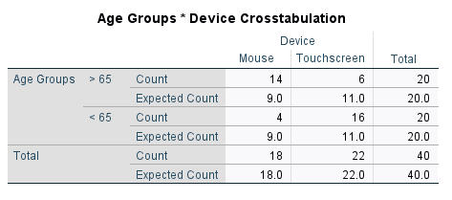
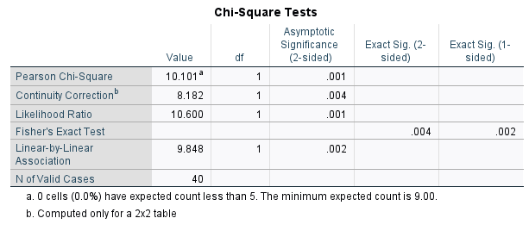
Chi-Squared Test results
What we would expect to observe if there was no association
What we actually observed
The Chi-Square test helps to determine if the observed counts are different enough for the test to be significant
The degree of freedom of a Chi-squared test is calculated by the following equation:
Degree of freedom = (Number of rows – 1) x (Number of columns – 1)
Χ²(1) = 10.1, p < 0. 05

Slide 15
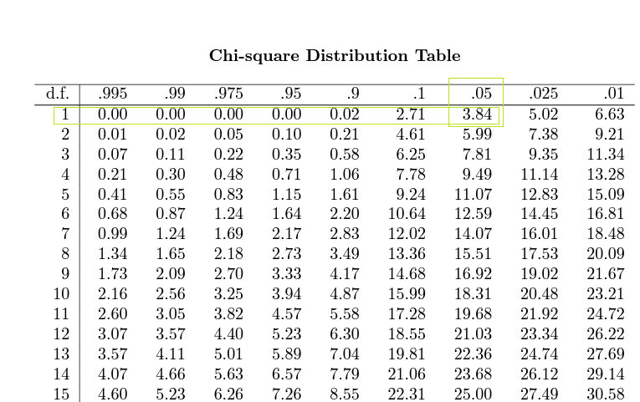
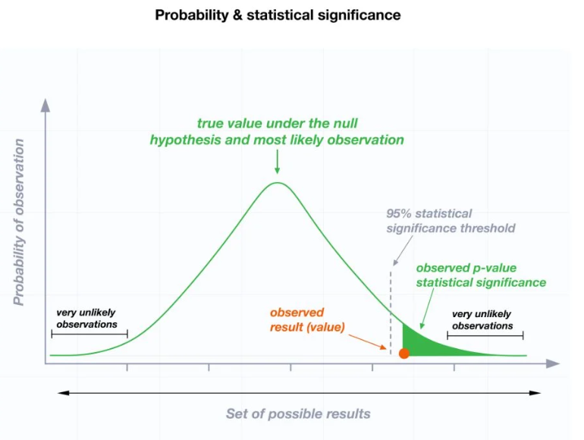
Chi-Squared Test interpretation of the results
Χ²(1) = 10.1, p < 0. 05 thus we reject the null hypothesis.
The Chi-Square test value is 10.101
The critical value for the test in the Chi-Square distribution table is determined by the cross-section of degrees of freedom and 0.05 alpha level, as we are looking at a confidence interval 95%.
Thus, according to the Chi-Square distribution table, the critical value of the test is 3.84
Our Χ²(1) = 10.1 is larger than the 3.84 thus we reject the null hypothesis
Chi-square Distribution Table link

Slide 16
Chi-Squared Test
A 3-by-3 Frequency Count Table
blank cell | Preferred Device
Age | Mouse | Touchscreen | Stylus
< 18 | 4 | 9 | 7
18–65 | 12 | 6 | 2
≥ 65 | 4 | 15 | 1
If we expand the study to three pointing devices and include children in it, we have three task conditions and three participant groups.

Slide 17
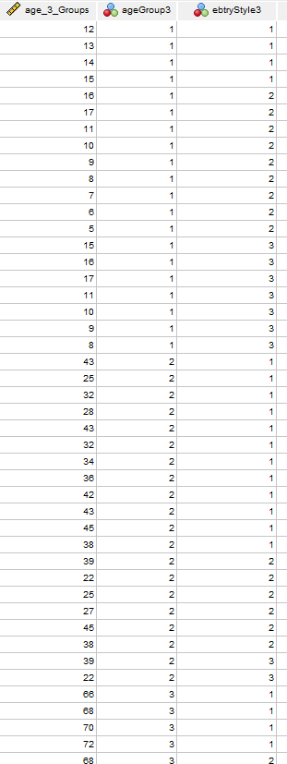
Chi-Squared Test – data organisation in SPSS
A 3-by-3 Frequency Count Table
blank cell | Preferred Device
Age | Mouse | Touchscreen | Stylus
< 18 | 4 | 9 | 7
18–65 | 12 | 6 | 2
≥ 65 | 4 | 15 | 1
If we expand the study to three pointing devices and include children in it, we have three task conditions and three participant groups.

Slide 18
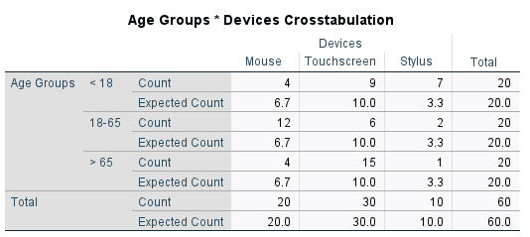
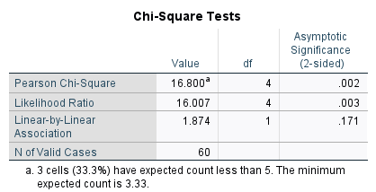
Run Chi-Squared Test in SPSS
A 3-by-3 Frequency Count Table
blank cell | Preferred Device
Age | Mouse | Touchscreen | Stylus
< 18 | 4 | 9 | 7
18–65 | 12 | 6 | 2
≥ 65 | 4 | 15 | 1
The degree of freedom of a Chi-squared test is calculated by the following equation:
Degree of freedom =
(Number of rows – 1) x (Number of columns – 1) =
(3-1) x (3-1) = 4
Χ²(4) = 16.8, p < 0. 05

Slide 19
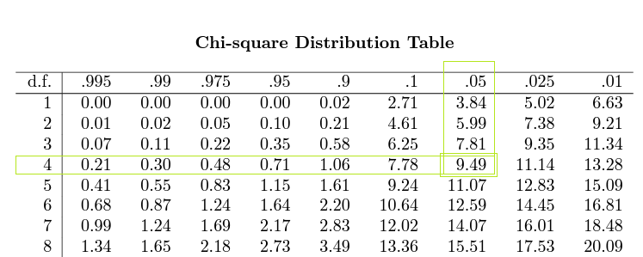
Chi-Squared Test interpretation of the results
Χ²(4) = 16.8, p < 0. 05 thus we reject the null hypothesis.
The Chi-Square test value is 16.8
The critical value for the test in the Chi-Square distribution table is determined by the cross-section of degrees of freedom and 0.05 alpha level, as we are looking at a confidence interval 95%.
Thus, according to the Chi-Square distribution table, the critical value of the test is 9.49
Our Χ²(1) = 16.8 is larger than the 9.49 thus we reject the null hypothesis
Chi-square Distribution Table link

Slide 20
Nonparametric tests are not assumption-free
The Chi-squared test requires two assumptions:
  the data points in the contingency table must be independent from each other
    In other words, one participant can only contribute one data point in the contingency table. To give a more specific example, you cannot have a participant that prefers both the mouse and the touchscreen.
  the Chi-squared test does not work well when the sample is too small.
  It is generally suggested that to acquire a robust Chi-square, the total sample size needs to be 20 or larger
  Camilli G, Hopkins K. (1978) Applicability of chi-square to 2 × 2 contingency tables with small expected cell frequencies. Psychological Bulletin. 1978;85(1):163–167.

Slide 21
Parametric vs Nonparametric
Parametric Alternative | Nonparametric test
Independent samples t-test | Mann-Whitney test
Paired sample t-test | Wilcoxon Signed Rank test
One-way ANOVA or Factorial ANOVA | Kruskal-Wallis test
Repeated ANOVA | Friedmans’s ANOVA
Correlation Coefficient | Spearman Rank Correlation
Same distribution
Symmetric distribution
Same distribution
Equal variances
Interval, ratio or ordinal
Monotonic relationship
Interval or ratio | Nominal or ordinal
Normally distributed | Not Normal distribution
No outliers | Outliers
Equal variances | Unequal variances
Large samples >30 | Small sample
Notes:
Every parametric test has the equivalent non parametric test

Slide 22
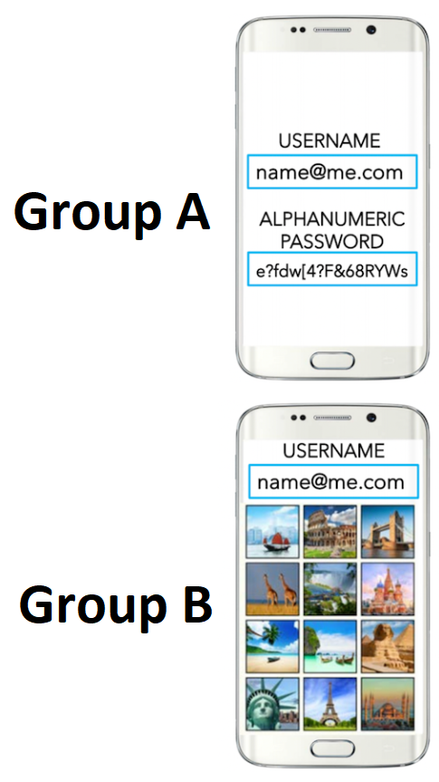
Mann-Whitney U test
Lets examine a scenario where we are evaluating two authentication techniques:
  a traditional alphanumeric password and
  an image-based password that contain several images preselected by the user.
You recruit two groups of participants.
Each group uses one authentication technique to complete a number of login tasks.
In addition to performance measures such as task completion time, failed login tasks, and keystroke level data, you also ask the participants to answer a questionnaire at the end of the study.
Each participant rates the general level of frustration when using the authentication technique through a 7-point Likert scale question (1 = least frustrated, 7 = most frustrated). contains

Slide 23
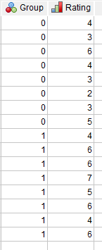
Mann-Whitney U test
Sample Data for Mann-Whitney U test
Group | Participants | Rating | Coding
Alphanumeric | Participant 1 | 4 | 0
Alphanumeric | Participant 2 | 3 | 0
Alphanumeric | Participant 3 | 6 | 0
Alphanumeric | Participant 4 | 4 | 0
Alphanumeric | Participant 5 | 3 | 0
Alphanumeric | Participant 6 | 2 | 0
Alphanumeric | Participant 7 | 4 | 0
Alphanumeric | Participant 8 | 5 | 0
Image-based | Participant 9 | 4 | 1
Image-based | Participant 10 | 6 | 1
Image-based | Participant 11 | 6 | 1
Image-based | Participant 12 | 7 | 1
Image-based | Participant 13 | 5 | 1
Image-based | Participant 14 | 6 | 1
Image-based | Participant 15 | 4 | 1
Image-based | Participant 16 | 6 | 1

Slide 24
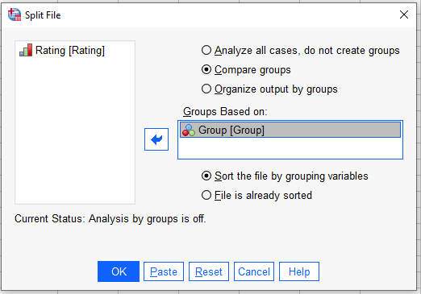
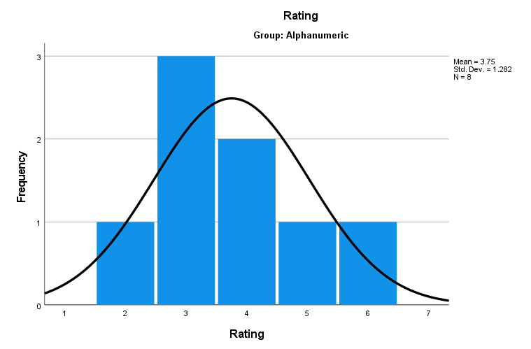
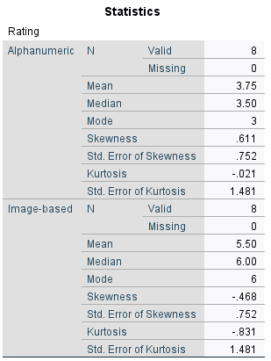
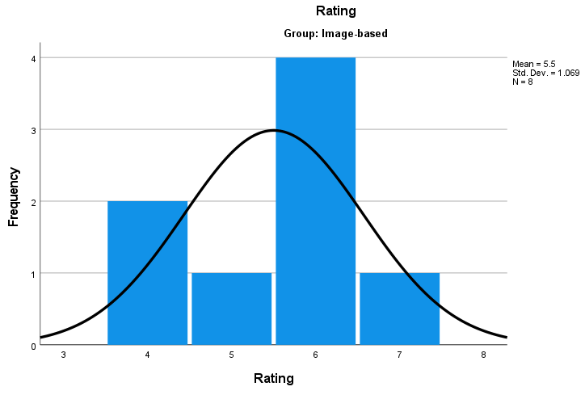
Descriptive statistics for the two groups

Slide 25
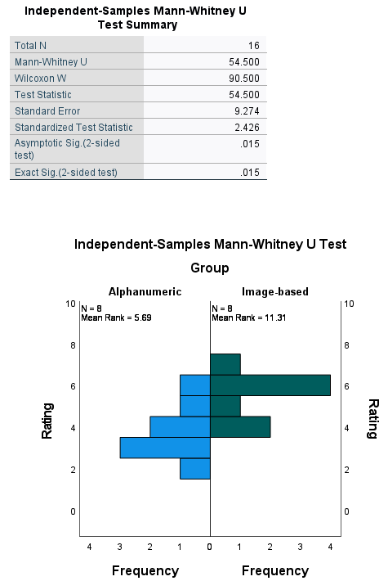
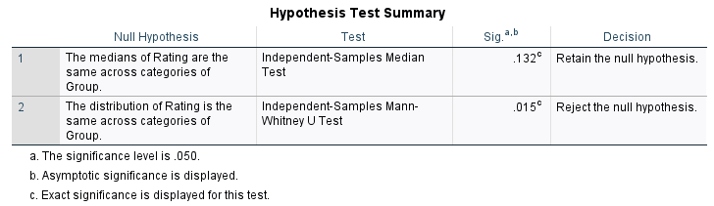
Mann-Whitney U test results and interpretation
Remember to unsplit the group and then run non-parametric statistics
According to the Mann-Whitney U test we reject the null hypothesis

Slide 26
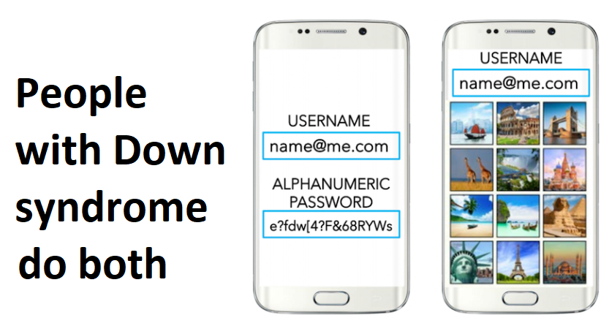
Wilcoxon Signed Rank test
Let us examine another scenario in which we are interested in the use of the two authentication techniques by people with Down syndrome
We can only successfully recruit 10 participants for the study
The small participant size suggests that a within-group design will be more appropriate
So each participant completes the study using both authentication techniques:
We are evaluating two authentication techniques:
  a traditional alphanumeric password and
  an image-based password that contain several images preselected by the user.
and answers a questionnaire after the interaction with each technique.

Slide 27
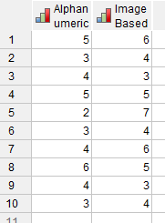
Wilcoxon Signed Rank test – organisation of data in SPSS
Sample Data for Wilcoxon Signed-Rank Test
Participants | Alphanumeric | Image-Based
Participant 1 | 5 | 6
Participant 2 | 3 | 4
Participant 3 | 4 | 3
Participant 4 | 5 | 5
Participant 5 | 2 | 7
Participant 6 | 3 | 4
Participant 7 | 4 | 6
Participant 8 | 6 | 5
Participant 9 | 4 | 3
Participant 10 | 3 | 4

Slide 28
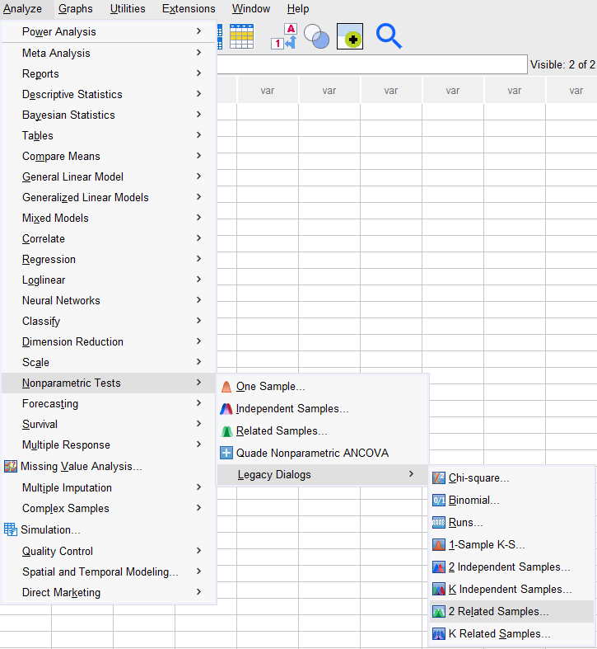
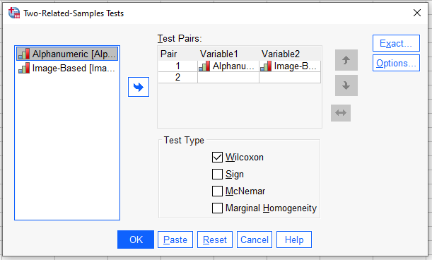
Wilcoxon Signed Rank test

Slide 29
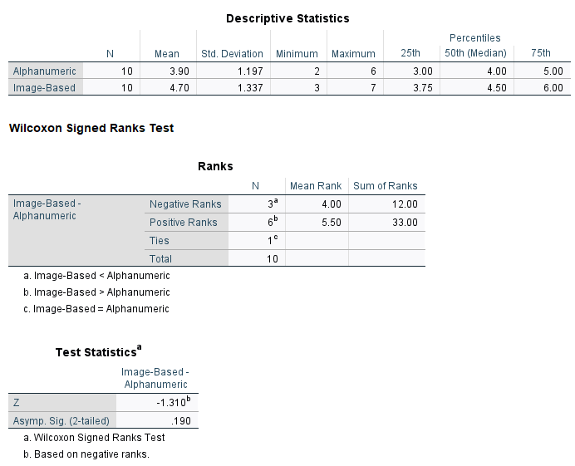
Wilcoxon Signed Rank test results
The result of the Wilcoxon signed-rank test is a normalized z score.
For this example, z = − 1.31 and p = 0.19.
There is no significant difference in the perceived level of frustration between the two techniques.

Slide 30
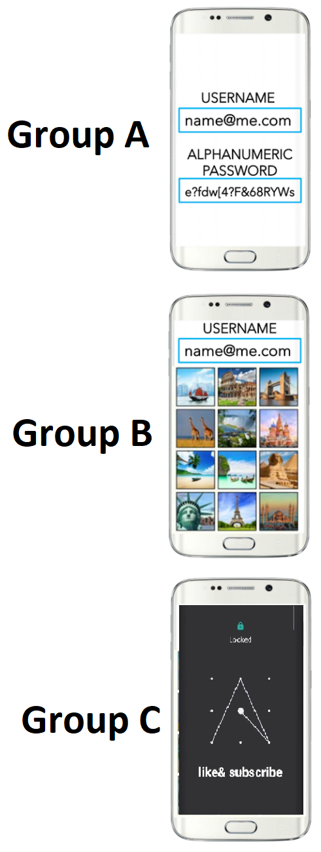
Kruskal-Wallis One-Way Analysis of Variance by Ranks
In the authentication study discussed previously, suppose we want to evaluate a drawing-based password technique in addition to the alphanumeric technique and the image-based technique, the study will include three conditions.
If you recruit three groups of participants and let each group use one authentication technique during the study, the data will be collected from independent samples and the frustration rating can be analyzed through the Kruskal-Wallis one-way ANOVA by ranks.

Slide 31
Kruskal-Wallis One-Way Analysis of Variance by Ranks
Sample Data for Kruskal-Wallis One-Way Analysis of Variance by Ranks
Group | Participants | Rating | Coding
Alphanumeric | Participant 1 | 5 | 0
Alphanumeric | Participant 2 | 3 | 0
Alphanumeric | Participant 3 | 4 | 0
Alphanumeric | Participant 4 | 4 | 0
Alphanumeric | Participant 5 | 2 | 0
Alphanumeric | Participant 6 | 3 | 0
Alphanumeric | Participant 7 | 3 | 0
Alphanumeric | Participant 8 | 2 | 0
Image-based | Participant 9 | 3 | 1
Image-based | Participant 10 | 5 | 1
Image-based | Participant 11 | 6 | 1
Image-based | Participant 12 | 4 | 1
Image-based | Participant 13 | 5 | 1
Image-based | Participant 14 | 4 | 1
Image-based | Participant 15 | 5 | 1
Image-based | Participant 16 | 5 | 1
Drawing-based | Participant 17 | 6 | 2
Drawing-based | Participant 18 | 4 | 2
Drawing-based | Participant 19 | 5 | 2
Drawing-based | Participant 20 | 5 | 2
Drawing-based | Participant 21 | 6 | 2
Drawing-based | Participant 22 | 7 | 2
Drawing-based | Participant 23 | 5 | 2
Drawing-based | Participant 24 | 7 | 2

Slide 32
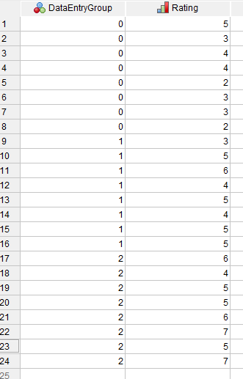
Kruskal-Wallis One-Way Analysis of Variance by Ranks

Slide 33
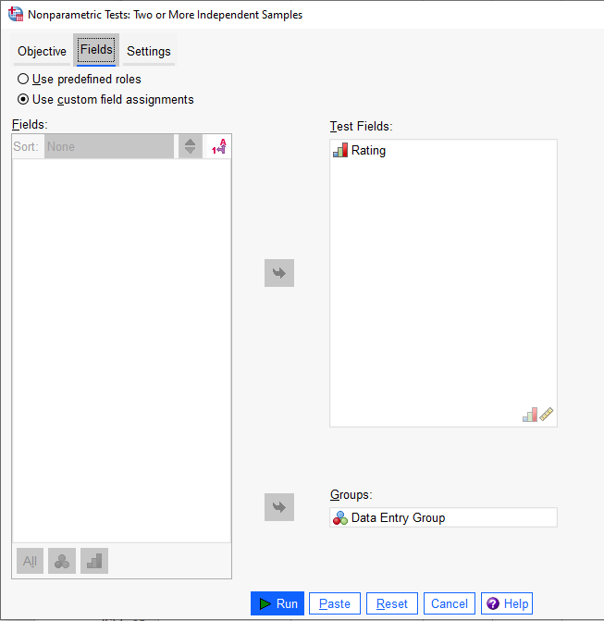
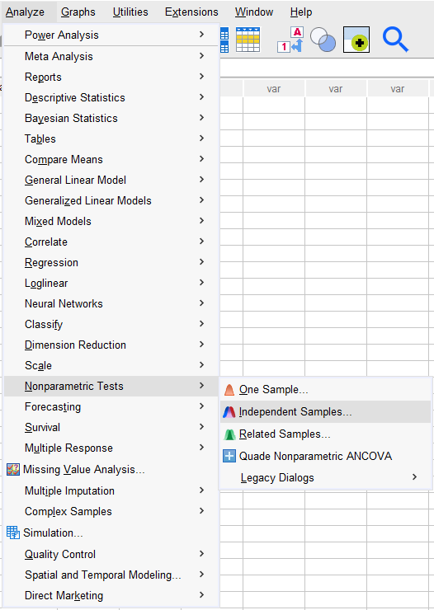
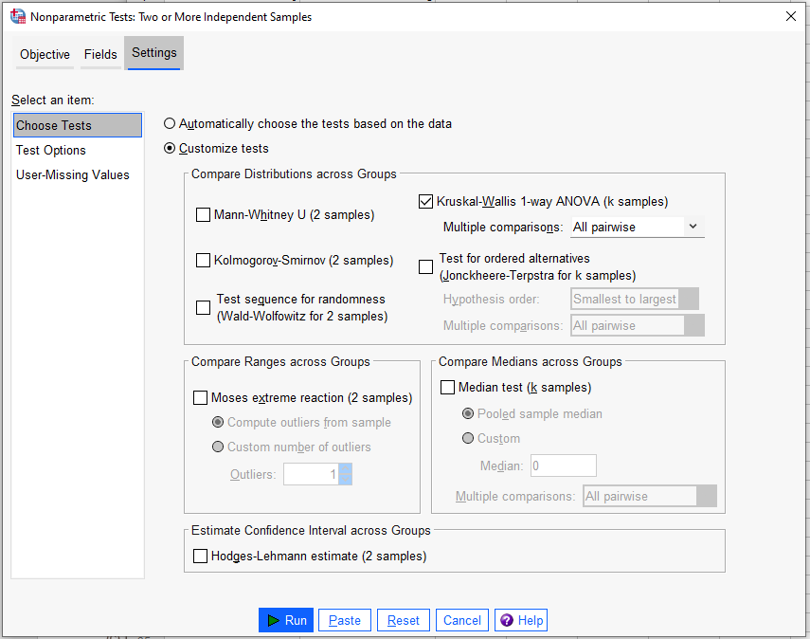
Kruskal-Wallis One-Way Analysis of Variance by Ranks

Slide 34
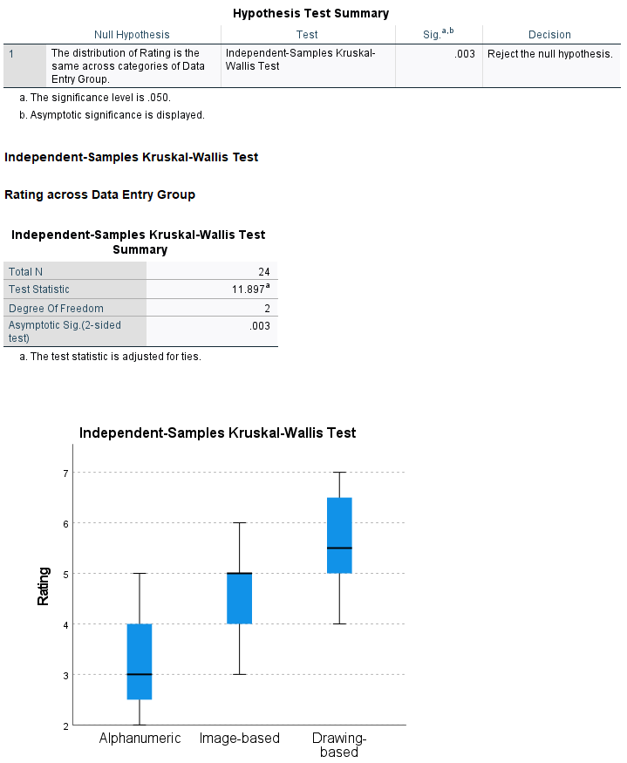
Kruskal-Wallis One-Way Analysis of Variance by Ranks
The result of the Kruskal-Wallis test is an H value.
In this example, H(2) = 11.897, p < 0.05.
Therefore, the null hypothesis is rejected.
The result suggests that there is significant difference in the perceived level of frustration between the three authentication techniques.

Slide 35
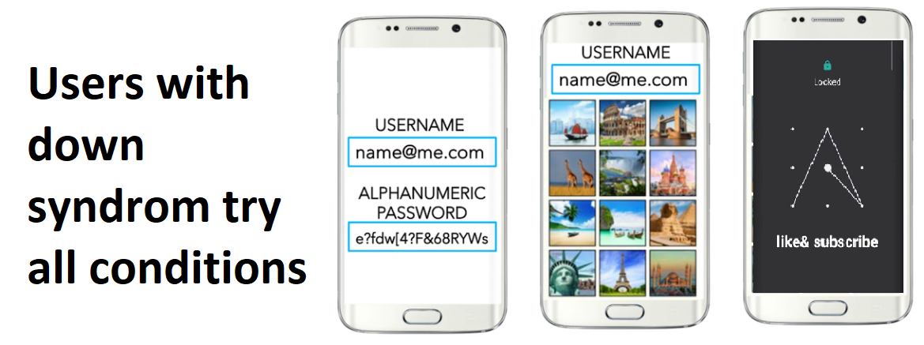
Friedman's Two-Way Analysis of Variance Test
Similarly, if you would like to evaluate the three authentication techniques when being used by people with Down syndrome, you may choose to adopt a within-group design that requires each participant to complete the tasks using all three authentication methods. In this case, the data can be analyzed through the Friedman's two-way ANOVA test.

Slide 36
Friedman's Two-Way Analysis of Variance Test
Sample Data for Friedman's Two-Way Analysis of Variance Test
Participants | Alphanumeric | Image-Based | Drawing-Based
Participant 1 | 2 | 4 | 6
Participant 2 | 4 | 5 | 6
Participant 3 | 3 | 3 | 5
Participant 4 | 5 | 5 | 3
Participant 5 | 5 | 7 | 7
Participant 6 | 3 | 4 | 5
Participant 7 | 4 | 2 | 3
Participant 8 | 1 | 5 | 4
Participant 9 | 4 | 3 | 4
Participant 10 | 5 | 2 | 3

Slide 37
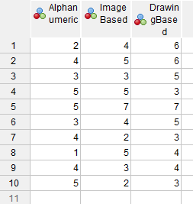
Friedman's Two-Way Analysis of Variance Test

Slide 38
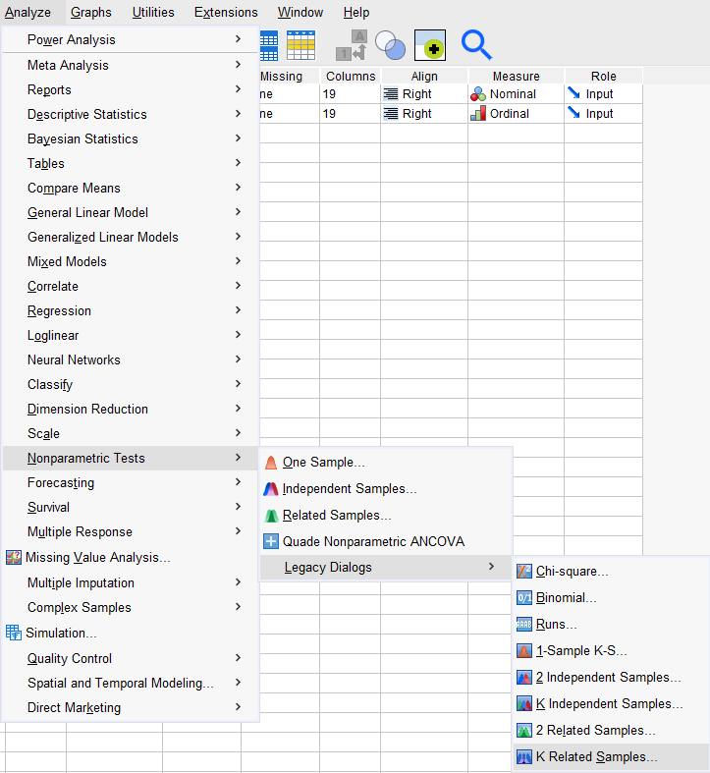
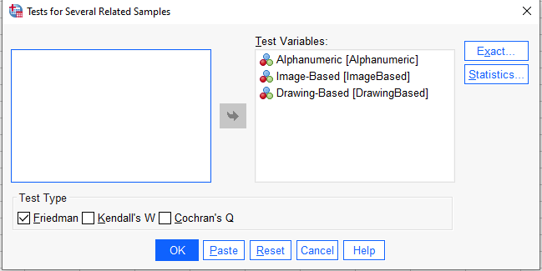
Friedman's Two-Way Analysis of Variance Test

Slide 39
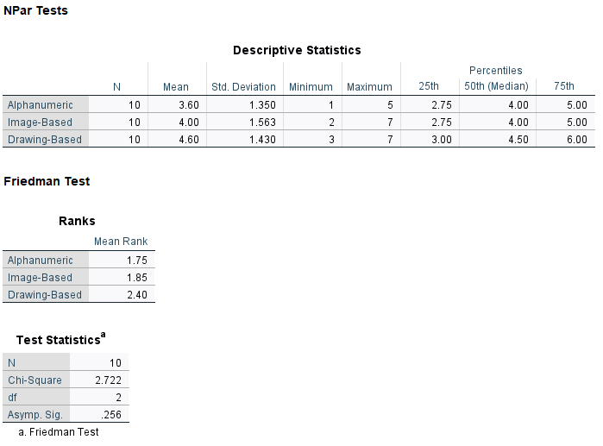
Friedman's Two-Way Analysis of Variance Test
The result of the Friedman's ANOVA test is an H value.
In this example, H(2) = 2.722, p = 0.256. There is no significant difference in the perceived level of frustration between the three techniques.

Slide 40
Summary
  Hypothesis testing process
  Non Parametric tests
  Chi-Squared Test
  Mann-Whitney U
  Wilcoxon Signed Rank
Parametric Alternative | Nonparametric test
Independent samples t-test | Mann-Whitney test
Paired sample t-test | Wilcoxon Signed Rank test
One-way ANOVA or Factorial ANOVA | Kruskal-Wallis test
Repeated ANOVA | Friedmans’s ANOVA
Correlation Coefficient | Spearman Rank Correlation

Slide 41
Test your understanding
What are the assumptions for parametric statistical tests?
When should nonparametric tests be considered?
Is the Chi-squared test “assumption free”? If not, what are the assumptions of a Chi-squared test?
What are the alternative nonparametric tests for the independent-samples t test, the paired-samples t test, the one-way ANOVA test, and the one-way repeated measures ANOVA test?

Slide 42
Reading
Lazar, J. et al. (2017) Research methods in human-computer interaction. Second edition. Cambridge, Massachusetts: Morgan Kaufmann Publishers.
  Chapter 3 Experimental design
  Chapter 4. Statistical analysis
MacKenzie S. Human-Computer Interaction: An Empirical Research Perspective. Waltham, MA: Elsevier; 2013.
Camilli G, Hopkins K. (1978) Applicability of chi-square to 2 × 2 contingency tables with small expected cell frequencies. Psychological Bulletin. 1978;85(1):163–167.
Online Resources
Turney, S. (2022, June 17). Turney, S. (2022, November 10). Chi-Square (Χ²) Table | Examples & Downloadable Table. Scribbr. Retrieved November 28, 2022, from https://www.scribbr.com/statistics/chi-square-distribution-table/

